Slide 1
Francis Bacon
-- the father of empiricism and the Scientific Revolution of the Renaissance period
罗康诚 信息科学技术学院

Slide 2
1.
Early life
1561~1581

Slide 3
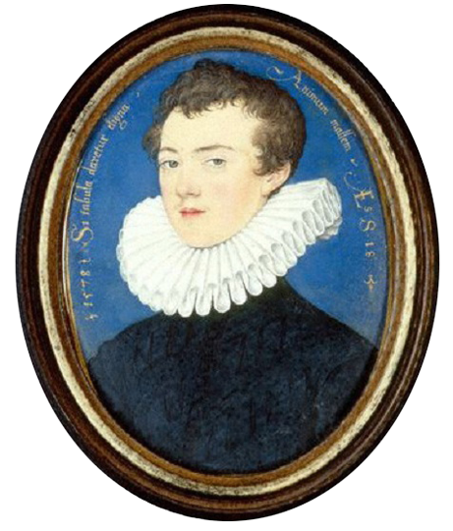
Timeline
travelled to the continent, studied civil law and became acquainted with political realities
elected to Parliament. He would remain a member of parliament for the next four decades.
1561
1576
1579
1581
Born 22 January 1561 near the Strand, London, England
the sudden death of his father meant Bacon returned home to London, where he began his practice of law at Gray’s Inn

Slide 4
2.
Political Life
1581~1621

Slide 5
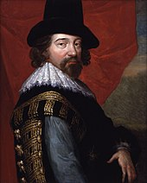
Four Stages
Parliamentarian (1581~1591)
Final years of the Queen's reign (1591~1603)
James I comes to the throne (1603~1621)
Lord Chancellor and public disgrace (1621)
Sir Francis Bacon, c. 1618

Slide 6
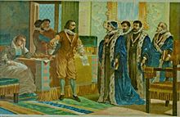
Lord Chancellor and public disgrace
Bacon's public career ended in disgrace in 1621. He was impeached by Parliament for corruption, as a victim to an intrigue in Parliament.

Slide 7
Bacon saw no way out for himself and declared himself guilty.
“My lords, it is my act, my hand, and my heart; I beseech your lordships to be merciful to a broken reed.”

Slide 8
3.
Influence and legacy

Slide 9
Philosophy and works
Scientific works
in which his ideas for a universal reform of knowledge into scientific methodology and the improvement of mankind's state using the Scientific method are presented.
Religious and literary works
in which he presents his moral philosophy and theological meditations.
Juridical works
in which his reforms in English Law are proposed.

Slide 10
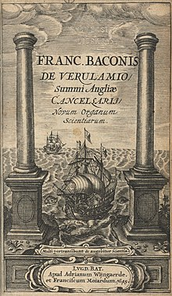
Scientific inquiry
Most influential
the duty of a scientist was to take a skeptical approach to any preconceptions, but only rely on the actual evidence and results of experiments.
Novum Organum (New organon《新工具》)
one of his most influential works, which expressed a new style of logic.

Slide 11
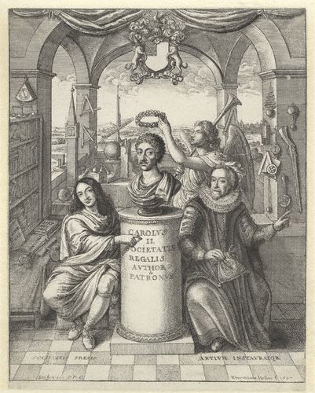
Frontispiece to 'The History of Royal-Society of London'
picturing Bacon (to the right) among the founding influences of the Society

Slide 12
the father of empiricism
the possibility of scientific knowledge based only upon inductive reasoning and careful observation of events in nature.
science could be achieved by the use of a skeptical and methodical approach whereby scientists aim to avoid misleading themselves.

Slide 13
the Napoleonic Code is
“the sole embodiment of Bacon‘s thought”
Bacon's legal work
"has had more success abroad than it has found at home“
--The historian William Hepworth Dixon

Slide 14
Law
Greatest contribution to be more about the evidence and facts of the case, and not get caught up in obtuse legal precedents.
A criticism
Bacon argued torture could be justified, to uncover plots of treason; though he did not admit it as useful for providing legal evidence.

Slide 15
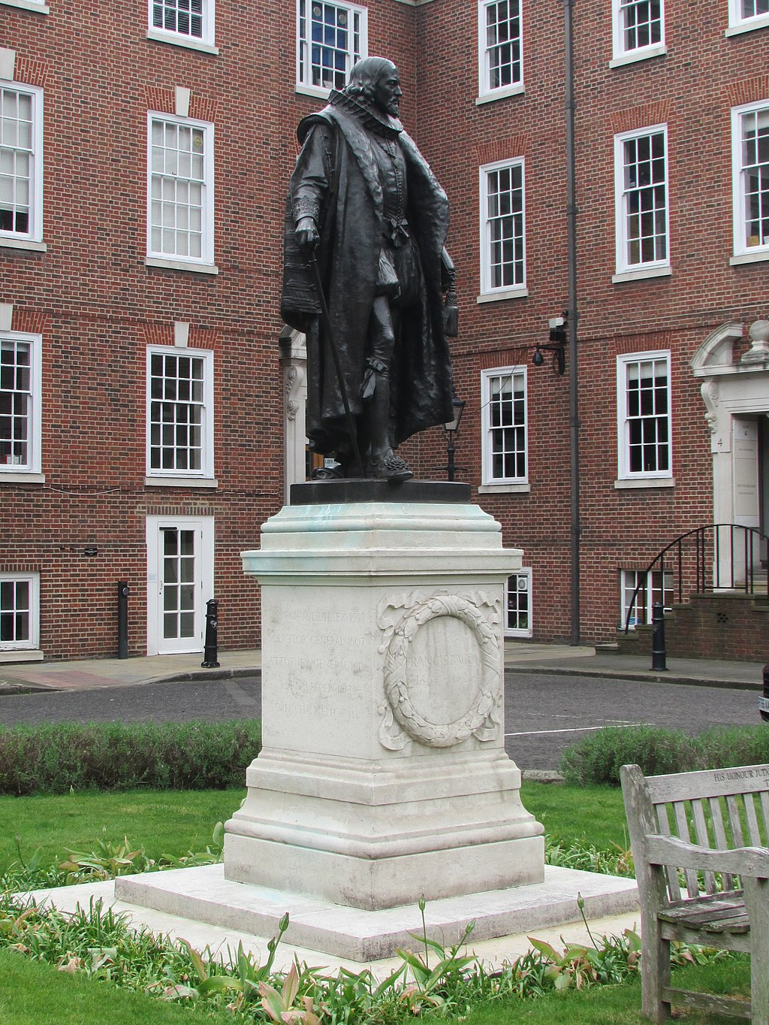
Law
Greatest contribution
place emphasis on the facts of the case, rather than a strict statement of legal precedent.
to be more about the evidence and facts of the case, and not get caught up in obtuse legal precedents.

Slide 16
Conclusion
revolutionary figure in constitutional law, science and philosophy

Slide 17
Thanks!

